Slide 1

Interceptor Pattern
Iliyan Mihaylov, SAP
Partner logo

Slide 2
Agenda
Definition
Problem
Solution
Example

Slide 3
Definition
Interceptor pattern is a software design pattern that is used when software systems or frameworks want to offer a way to change, or augment, their usual processing cycle.
Key aspects of the pattern are that the change is transparent and used automatically.
Interceptor pattern is fundamental pattern for aspect-oriented programming (AOP). Aspect-oriented programming entails breaking down program logic into distinct parts (so-called concerns, cohesive areas of functionality).

Slide 4
Problem
In NEO SCP we have multiple REST API/s which are open for public invocation and these API/s should have a way to rate limit the requests to them. Some of this request is async and should be rate limited based on parallel execution instead of requests per second.
We should provide a process of limiting the rate that an API is being used in a server. It should limit the number of service requests which can be executed in parallel. The essential is to limit the load on a server and to keep it performing smoothly.

Slide 5
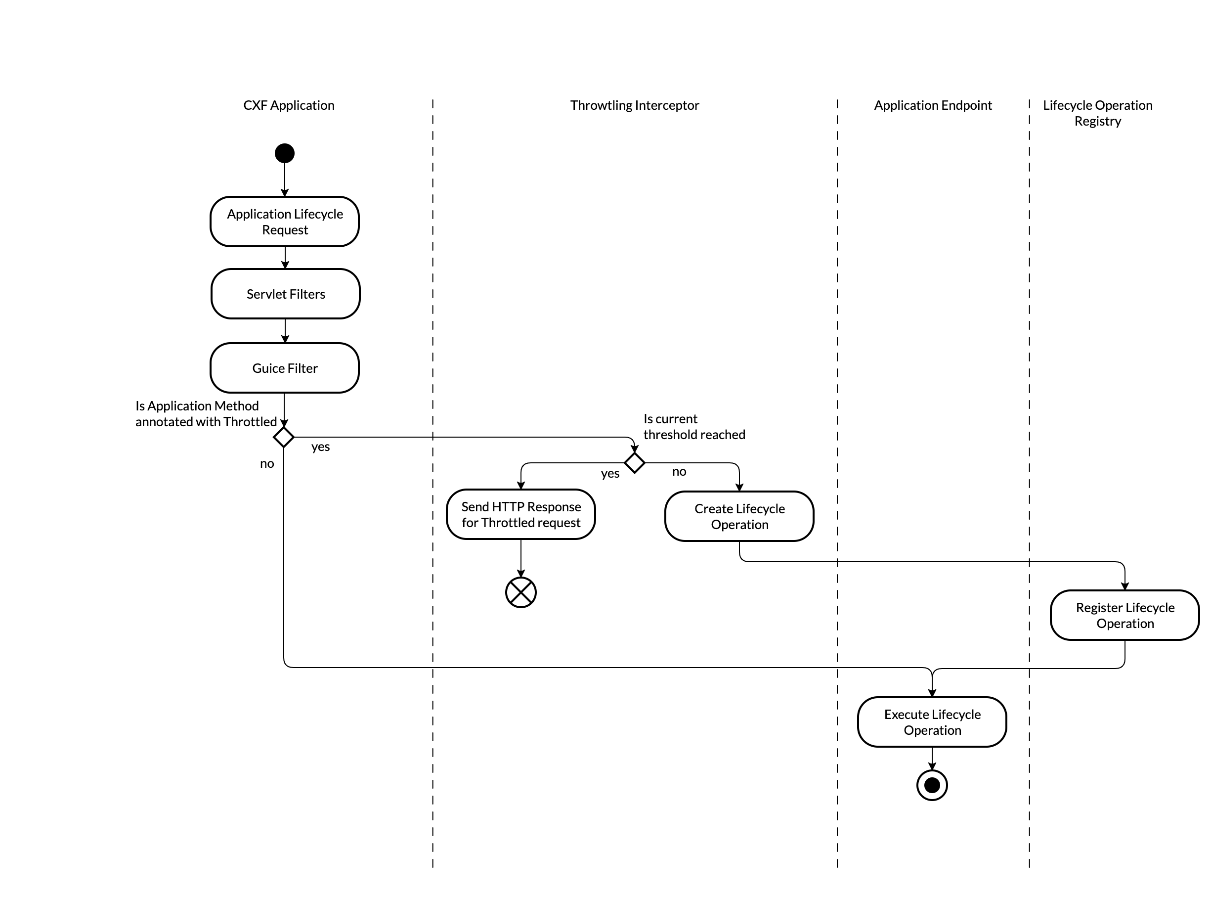
Solution

Slide 6
Prov Cons
Prov:
Open Close Principal
Easy Testing
Decoupling
Reusable
Cons:
Hard Debugging and Problem Investigation
In some cases can be a hidden functionality

Slide 7
Thank you.
Iliyan Mihaylov
iliyan.mihaylov@sap.com
Partner logo

